Slide 1
MONITORS
A monitor type is an ADT that includes a set of programmer-defined operations that are provided with mutual exclusion within the monitor
An abstract data type—or ADT—encapsulates data with a set of functions to operate on that data that are independent of any specific implementation of the ADT.
A function defined within a monitor can access only those variables declared locally within the monitor and its formal parameters. Similarly, the local variables of a monitor can be accessed by only the local functions.
The monitor construct ensures that only one process at a time is active within the monitor

Slide 2
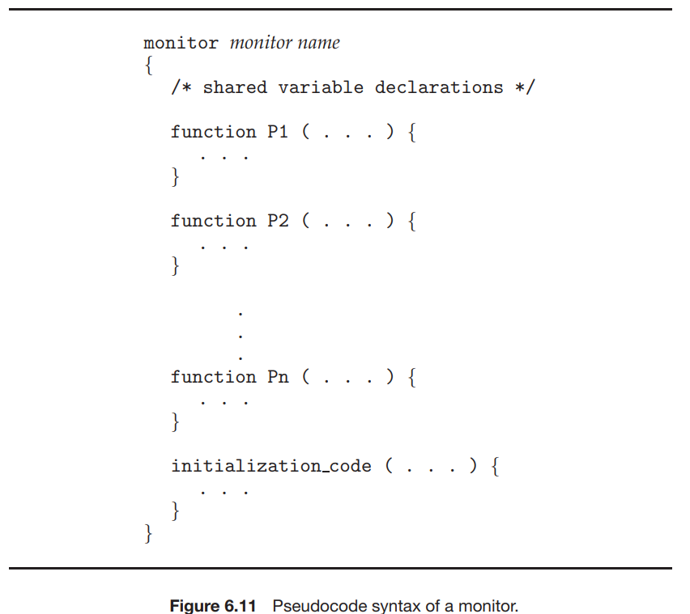

Slide 3
A programmer who needs to write a tailor-made synchronization scheme can define one or more variables of type condition:
condition x, y;
The only operations that can be invoked on a condition variable are wait() and signal().
  The operation x.wait(); means that the process invoking this operation is suspended until another process invokes x.signal();
The x.signal() operation resumes exactly one suspended process. If no process is suspended, then the signal() operation has no effect; that is, the state of x is the same as if the operation had never been executed

Slide 4
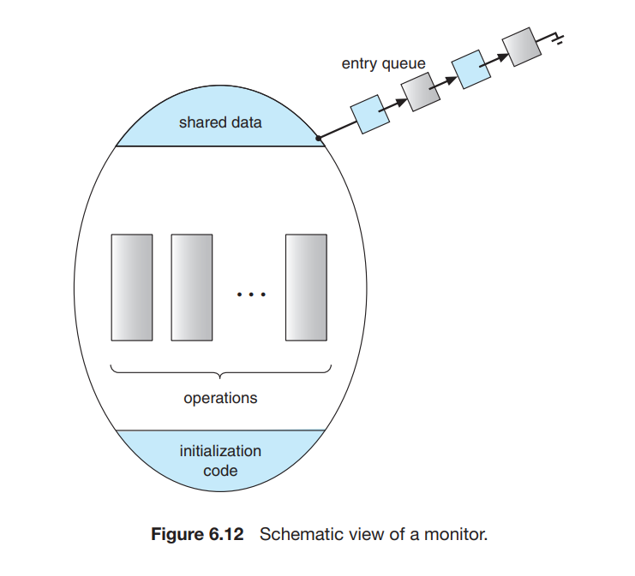

Slide 5
How deadlocks occur
Consider a system consisting of two processes, P0 and P1, each accessing two semaphores, S and Q, set to the value 1.
Suppose that P0 executes wait(S) and then P1 executes wait(Q). When P0 executes wait(Q), it must wait until P1 executes signal(Q). Similarly, when P1 executes wait(S), it must wait until P0 executes signal(S). Since these signal() operations cannot be executed, P0 and P1 are deadlocked

Slide 6
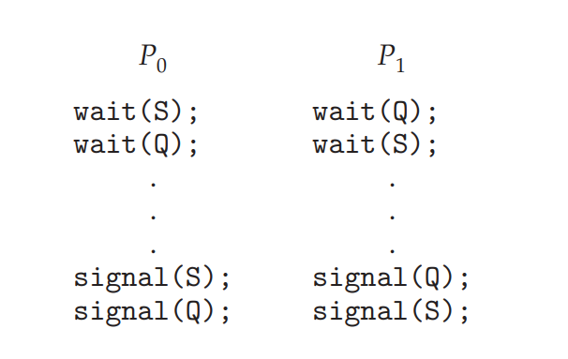

Slide 7
Classic Problems of Synchronization
The Bounded Buffer Problem
The Reader Writers problem
The Dining Philosophers Problem

Slide 8
The Bounded-Buffer (Producer Consumer Problem)
The problem describes two processes, the producer and the consumer, which share a common, fixed-size buffer .
Producer produces information by inserts data into empty slots of buffer.
Consumer consumes information by removing data from the filled in slots of buffer.
Producer must not produce when the buffer is full.
Consumer must not consume when the buffer is empty.
Producer and consumer should not insert and remove simultaneously.

Slide 9
The producer and consumer processes share the following data structures:
              int n;
              semaphore mutex = 1;
              semaphore empty = n;
              semaphore full = 0
The pool consists of n buffers, each capable of holding one item.
The mutex binary semaphore provides mutual exclusion for accesses to the buffer pool and is initialized to the value 1.
The empty and full semaphores count the number of empty and full buffers. The semaphore empty is initialized to the value n; the semaphore full is initialized to the value 0.

Slide 10
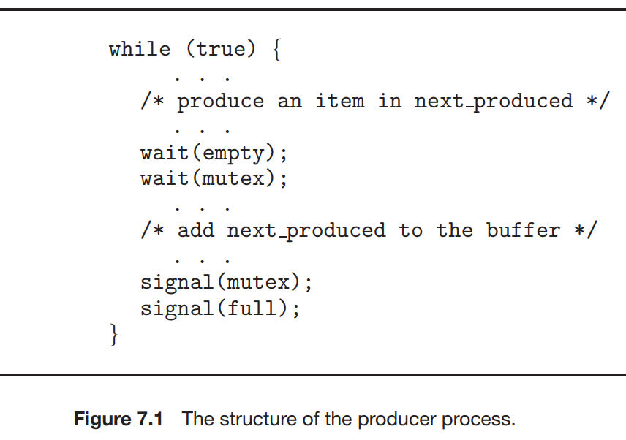
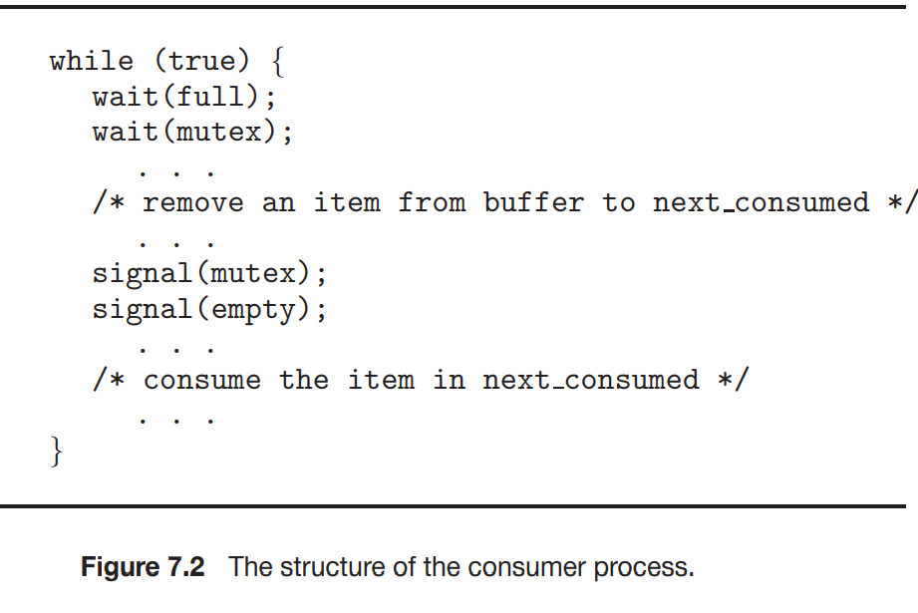

Slide 11
The Reader Writers problem
The Readers-Writers Problem is a classic synchronization issue in operating systems that involves managing access to shared data by multiple threads or processes. The problem addresses the scenario where:
  Readers: Multiple readers can access the shared data simultaneously without causing any issues because they are only reading and not modifying the data.
  Writers: Only one writer can access the shared data at a time to ensure data integrity, as writers modify the data, and concurrent modifications could lead to data corruption or inconsistencies.

Slide 12
The challenge now becomes how to create a synchronization scheme such that the following is supported:
Multiple Readers: A number of readers may access simultaneously if no writer is presently writing.
Exclusion for Writers: If one writer is writing, no other reader or writer may access the common resource.
In the solution to the first readers–writers problem, the reader processes share the following data structures:
                semaphore rw_mutex = 1;
                semaphore mutex = 1;
                int read_count = 0;

Slide 13
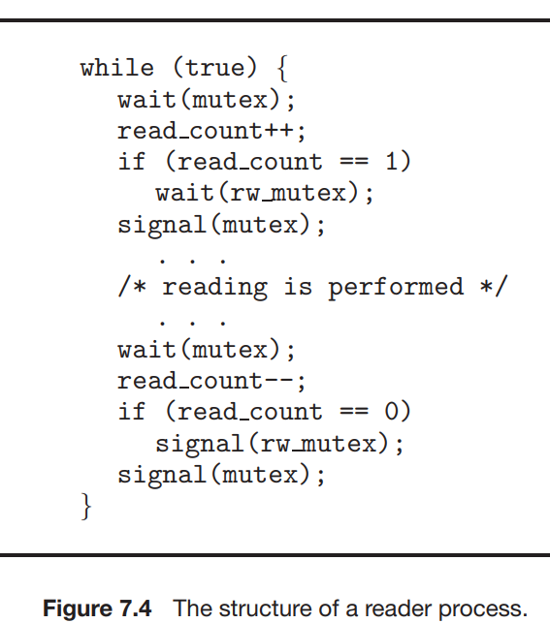
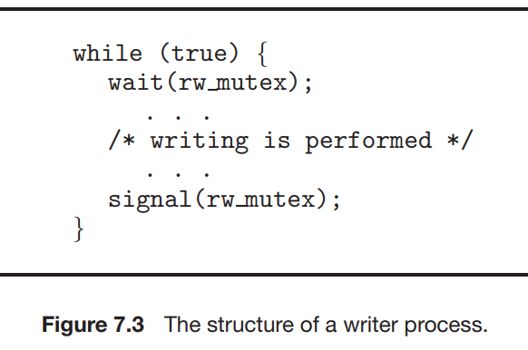

Slide 14
The mutex semaphore is used to ensure mutual exclusion when the variable read count is updated.
The read_count variable keeps track of how many processes are currently reading the object.
The semaphore rw_mutex functions as a mutual exclusion semaphore for the writers.
  It is also used by the first or last reader that enters or exits the critical section. It is not used by readers that enter or exit while other readers are in their critical sections

Slide 15
The Dining Philosophers problem
The Dining Philosopher Problem is a classic synchronization and concurrency problem that deals with resource sharing, deadlock, and starvation in systems where multiple processes require limited resources.
The Dining Philosopher Problem involves ‘n’ philosophers sitting around a circular table.
Each philosopher alternates between two states: thinking and eating.
To eat, a philosopher needs two chopsticks, one on their left and one on their right.
However, the number of chopsticks is equal to the number of philosophers, and each chopstick is shared between two neighboring philosophers.

Slide 16
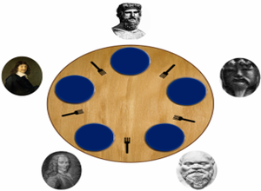

Slide 17
Constraints and Conditions for the Problem
Every Philosopher needs two forks to eat.
Every Philosopher may pick up the forks on the left or right but only one fork at once.
Philosophers only eat when they have two forks. We have to design such a protocol i.e. pre and post protocol which ensures that a philosopher only eats if he or she has two forks.

Slide 18
Solution using monitors :
Monitor presents a deadlock-free solution to the dining-philosophers problem.
This solution imposes the restriction that a philosopher may pick up her chopsticks only if both of them are available.
To code this solution, we need to distinguish among three states in which we may find a philosopher.
  For this purpose, we introduce the following data structure:
    enum {THINKING, HUNGRY, EATING} state[5];

Slide 19
Philosopher i can set the variable state[i] = EATING only if her two neighbors are not eating:
  (state[(i+4) % 5] != EATING) and (state[(i+1) % 5] != EATING).
We also need to declare condition self[5];
  This allows philosopher i to delay self when she/he is hungry but is unable to obtain the chopsticks she/he needs.

Slide 20
